Slide 1
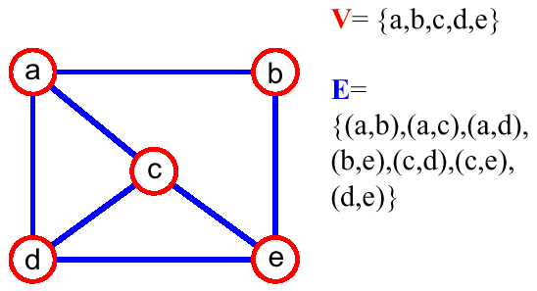
Graphs – Definition
A graph G = (V,E) is composed of:
  V: set of vertices
  E⊂ V× V: set of edges connecting the vertices
An edge e = (u,v) is a pair of vertices
(u,v) is ordered, if G is a directed graph

Slide 2
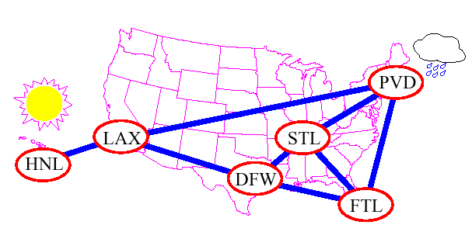
Applications
Transportation and communication networks
Modeling any sort of relationtionships (between components, people, processes, concepts)

Slide 3
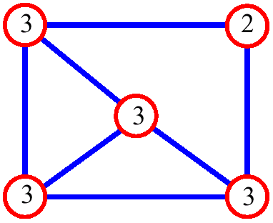
Graph Terminology
adjacent vertices: connected by an edge
degree (of a vertex): # of adjacent vertices
path: sequence of vertices v₁ ,v₂ ,. . .v_{k} such that consecutive vertices v_{i} and v_{i+1} are adjacent
Since adjacent vertices each count the adjoining edge, it will be counted twice

Slide 4
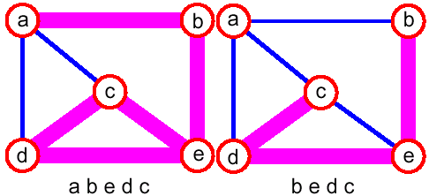
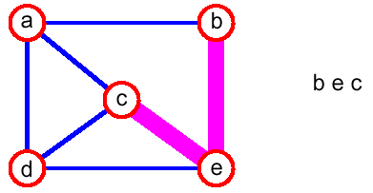
Graph Terminology (2)
simple path: no repeated vertices

Slide 5
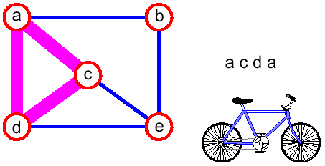
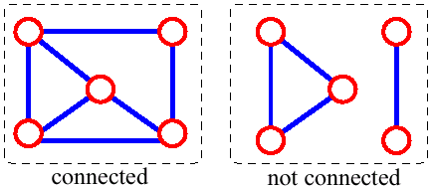
Graph Terminology (3)
cycle: simple path, except that the last vertex is the same as the first vertex
connected graph: any two vertices are connected by some path

Slide 6
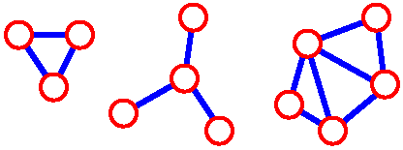
Graph Terminology (4)
subgraph: subset of vertices and edges forming a graph
connected component: maximal connected subgraph. E.g., the graph below has 3 connected components

Slide 7
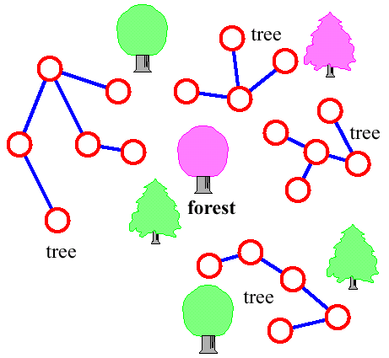
Graph Terminology (5)
(cycle-free) tree - connected graph without cycles
forest - collection of trees

Slide 8
Data Structures for Graphs
How can we represent a graph?

Slide 9
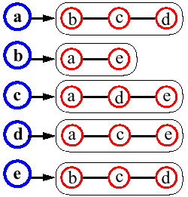
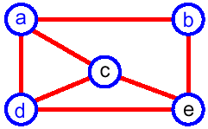
Adjacency List
The Adjacency list of a vertex v: a sequence of vertices adjacent to v
Represent the graph by the adjacency lists of all its vertices

Slide 10
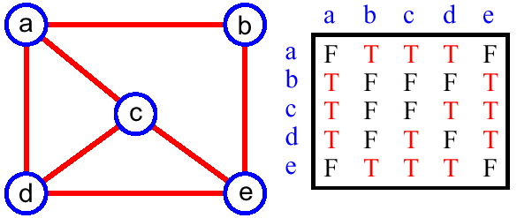
Adjacency Matrix
Matrix M with entries for all pairs of vertices
M[i,j] = true – there is an edge (i,j) in the graph
M[i,j] = false – there is no edge (i,j) in the graph
Space = O(n²)

Slide 11
Graph Searching Algorithms
Systematic search of every edge and vertex of the graph
Graph G = (V,E) is either directed or undirected
Today's algorithms assume an adjacency list representation
Applications
  Maze-solving
  Mapping
  Networks: routing, searching, clustering, etc.

Slide 12
Breadth First Search
A Breadth-First Search (BFS) traverses a connected component of a graph, and in doing so defines a spanning tree with several useful properties
The starting vertex s is assigned a distance 0.
In the first round, the string is unrolled the length of one edge, and all of the edges that are only one edge away from the anchor are visited (discovered), and assigned distances of 1

Slide 13
Breadth-First Search (2)
In the second round, all the new edges that can be reached by unrolling the string 2 edges are visited and assigned a distance of 2
This continues until every vertex has been assigned a level
The label of any vertex v corresponds to the length of the shortest path (in terms of edges) from s to v

Slide 14
BFS Example
r
s
t
u
r
s
t
u
∞
0
∞
∞
1
0
∞
∞
Q
s
Q
w
r
∞
∞
∞
∞
0
∞
1
∞
∞
1
1
v
w
x
y
v
w
x
y
r
s
t
u
r
s
t
u
1
0
2
∞
1
0
2
∞
Q
r
t
x
Q
t
x
v
∞
1
2
∞
1
2
2
2
1
2
∞
2
2
2
v
w
x
y
v
w
x
y

Slide 15
BFS Example
r
s
t
u
r
s
t
u
1
0
2
3
1
0
2
3
Q
x
v
u
Q
v
u
y
2
1
2
∞
2
2
3
2
1
2
3
2
3
3
v
w
x
y
v
w
x
y
r
s
t
u
r
s
t
u
1
0
2
3
1
0
2
3
Q
u
y
Q
y
2
1
2
3
3
3
2
1
2
3
3
v
w
x
y
v
w
x
y

Slide 16
BFS Example: Result
r
s
t
u
1
0
2
3
Q
-
2
1
2
3
v
w
x
y

Slide 17
BFS Algorithm
BFS(G,s)
01 for each vertex u ∈ V[G]-{s}
02 color[u] ← white
03 d[u] ← ∞
04 π[u] ← NIL
05 color[s] ← gray
06 d[s] ← 0
07 π[u] ← NIL
08 Q ← {s}
09 while Q ≠ ∅ do
10 u ← head[Q]
11 for each v ∈ Adj[u] do
12 if color[v] = white then
13 color[v] ← gray
14 d[v] ← d[u] + 1
15 π[v] ← u
16 Enqueue(Q,v)
17 Dequeue(Q)
18 color[u] ← black
Init all vertices
Init BFS with s
Handle all u’s children before handling any children of children

Slide 18
BFS Running Time
Given a graph G = (V,E)
  Vertices are enqueued if there color is white
  Assuming that en- and dequeuing takes O(1) time the total cost of this operation is O(V)
  Adjacency list of a vertex is scanned when the vertex is dequeued (and only then…)
  The sum of the lengths of all lists is Θ(E). Consequently, O(E) time is spent on scanning them
  Initializing the algorithm takes O(V)
Total running time O(V+E) (linear in the size of the adjacency list representation of G)

Slide 19
BFS Properties
Given a graph G = (V,E), BFS discovers all vertices reachable from a source vertex s
It computes the shortest distance to all reachable vertices
It computes a breadth-first tree that contains all such reachable vertices
For any vertex v reachable from s, the path in the breadth first tree from s to v, corresponds to a shortest path in G

Slide 20
Depth-First Search
A depth-first search (DFS) in an undirected graph G is the following
  We start at vertex s, tying the end of our string to the point and painting s “visited (discovered)”. Next we label s as our current vertex called u
  Now, we travel along an arbitrary edge (u,v).
  If edge (u,v) leads us to an already visited vertex v we return to u
  If vertex v is unvisited, we unroll our string, move to v, paint v “visited”, set v as our current vertex, and repeat the previous steps

Slide 21
Depth-First Search (2)
Eventually, we will get to a point where all incident edges on u lead to visited vertices
We then backtrack by unrolling our string to a previously visited vertex v. Then v becomes our current vertex and we repeat the previous steps
Then, if all incident edges on v lead to visited vertices, we backtrack as we did before. We continue to backtrack along the path we have traveled, finding and exploring unexplored edges, and repeating the procedure

Slide 22
DFS Algorithm
Initialize – color all vertices white
Visit each and every white vertex using DFS-Visit
Each call to DFS-Visit(u) roots a new tree of the depth-first forest at vertex u
A vertex is white if it is undiscovered
A vertex is gray if it has been discovered but not all of its edges have been discovered
A vertex is black after all of its adjacent vertices have been discovered (the adj. list was examined completely)

Slide 23
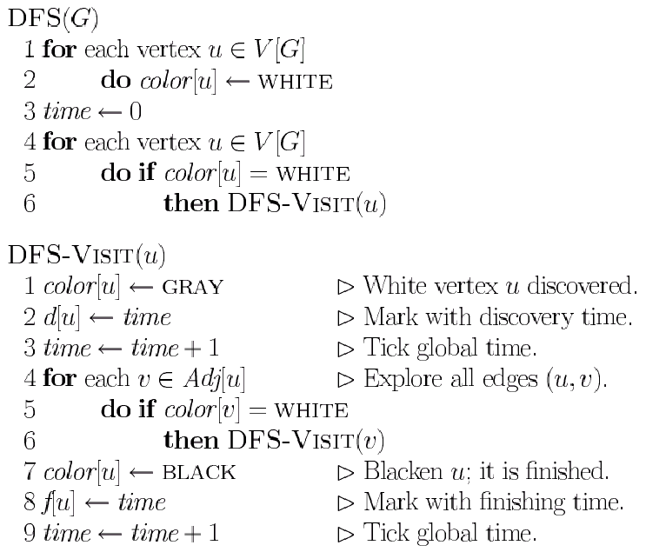
DFS Algorithm (2)
Init all vertices
Visit all children recursively

Slide 24
DFS Example
u
v
w
u
v
w
u
v
w
1/
1/
2/
1/
2/
3/
x
y
z
x
y
z
x
y
z
u
v
w
u
v
w
u
v
w
1/
2/
1/
2/
1/
2/
B
B
4/
3/
4/
3/
4/5
3/
x
y
z
x
y
z
x
y
z

Slide 25
DFS Example (2)
u
v
w
u
v
w
u
v
w
1/
2/
1/
2/7
1/
2/7
B
B
F
B
4/5
3/6
4/5
3/6
4/5
3/6
x
y
z
x
y
z
x
y
z
u
v
w
u
v
w
u
v
w
1/8
2/7
1/8
2/7
9/
1/8
2/7
9/
B
B
B
C
F
F
F
4/5
3/6
4/5
3/6
4/5
3/6
x
y
z
x
y
z
x
y
z

Slide 26
DFS Example (3)
u
v
w
u
v
w
u
v
w
1/8
2/7
9/
1/8
2/7
9/
1/8
2/7
9/
B
C
B
C
B
C
F
F
F
4/5
3/6
10/
4/5
3/6
10/
B
4/5
3/6
10/11
B
x
y
z
x
y
z
x
y
z
u
v
w
1/8
2/7
9/12
B
C
F
4/5
3/6
10/11
B
x
y
z

Slide 27
Predecessor Subgraph
Define slightly different from BFS
The PD subgraph of a depth-first search forms a depth-first forest composed of several depth-first trees
The edges in G_{π} are called tree edges

Slide 28
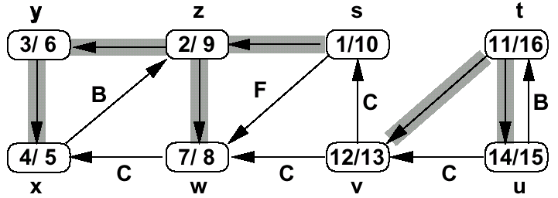
DFS Timestamping
The DFS algorithm maintains a monotonically increasing global clock
  discovery time d[u] and finishing time f[u]
For every vertex u, the inequality d[u] < f[u] must hold

Slide 29
DFS Timestamping
Vertex u is
  white before time d[u]
  gray between time d[u] and time f[u], and
  black thereafter
Notice the structure througout the algorithm.
  gray vertices form a linear chain
  correponds to a stack of vertices that have not been exhaustively explored (DFS-Visit started but not yet finished)

Slide 30
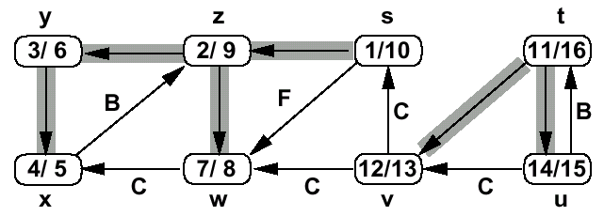
DFS Edge Classification
Tree edge (gray to white)
  encounter new vertices (white)
Back edge (gray to gray)
  from descendant to ancestor

Slide 31
DFS Edge Classification (2)
Forward edge (gray to black)
  from ancestor to descendant
Cross edge (gray to black)
  remainder – between trees or subtrees

Slide 32
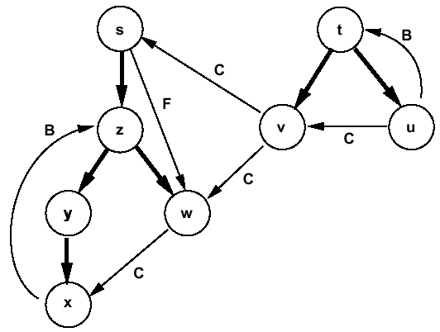
DFS Edge Classification (3)
Tree and back edges are important
Most algorithms do not distinguish between forward and cross edges

